Slide 1
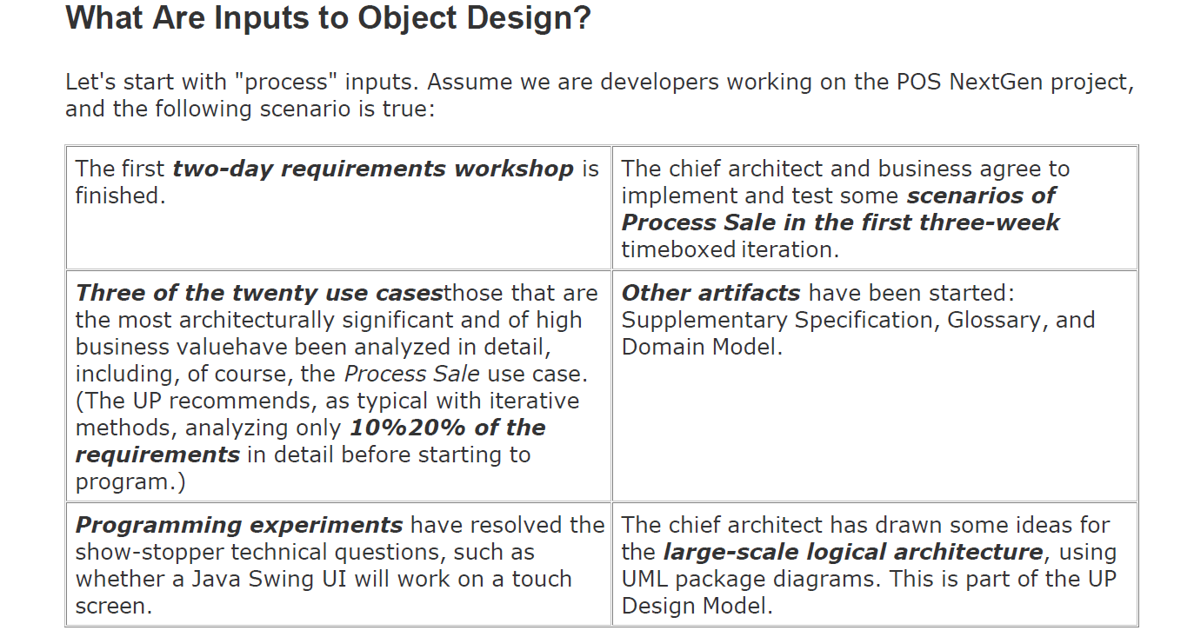
UML Vs design principles

Slide 2
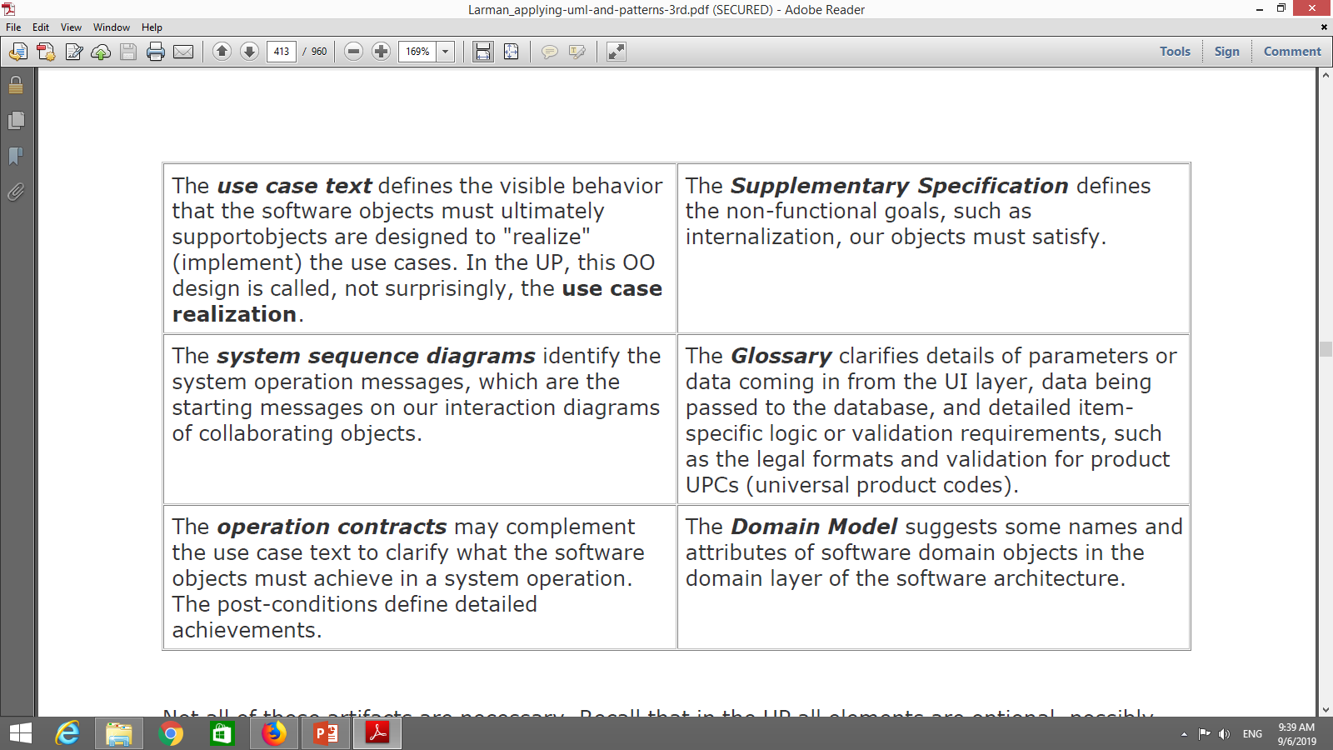

Slide 3
Activities of object design
Given the inputs,
Start immediate coding
Start UML modeling for the object design or another modeling technique-RDD

Slide 4
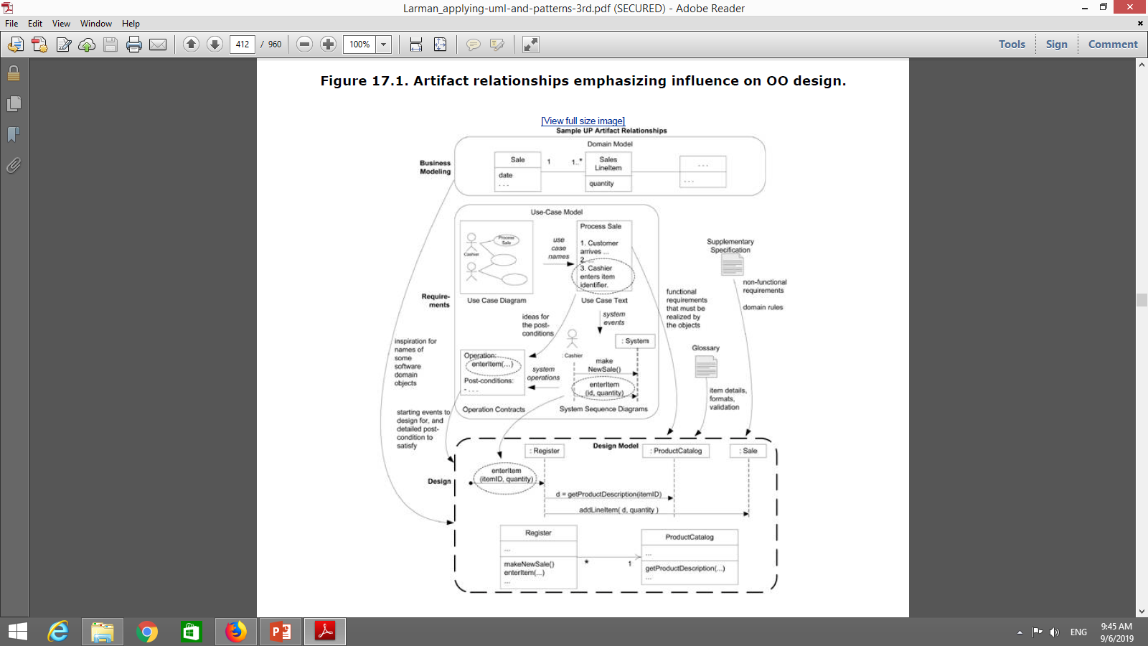
What are the outputs?

Slide 5
UML interaction, class and package diagrams
UI sketches and prototypes
Database models
Report sketches and prototypes

Slide 6
RDD
Doing
doing something to itself
initiating action in other objects
Controlling and coordinating activities in other objects
Knowing
Knowing about private data
Knowing about related objects
Knowing about things it can derive or calculate

Slide 7
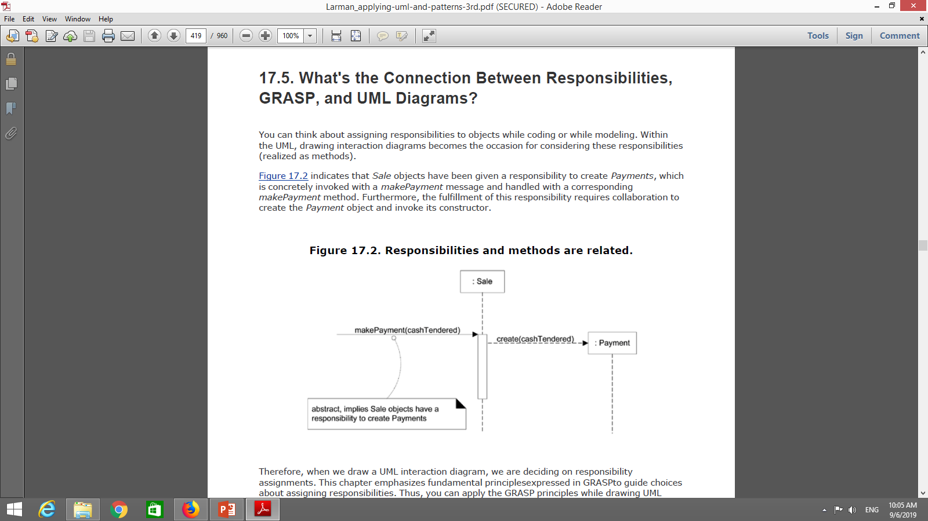

Slide 8
Pattern – named description of problem and solution pair
Pattern name: Information Expert
Problem: What is a basic principle by which to assign
responsibilities to objects?
Solution: Assign responsibility to the class that has the
information needed to fulfill it.

Slide 9
GRASP PATTERNS
Information Expert (Expert)
Creator
Controller
Low coupling
High cohesion
Polymorphism
Pure Fabrication
Indirection
Protected Variation

Slide 10
GRASP Patterns
General Responsibility Assignment Software Patterns.
Recognize that according to Craig Larman:
“The skillful assignment of responsibilities is extremely important in object design,
Determining the assignment of responsibilities often occurs during the creation of interaction diagrams and certainly during programming.”

Slide 11
GRASP Patterns
A Design Model may have
hundreds or even thousands of software classes and hundreds or thousands of responsibilities to be assigned.
During object design, when interactions between objects
are defined; we make choices about the assignment of
responsibilities to software classes..

Slide 12
1. Information Expert (or Expert)
We start by looking at the Expert Pattern (or Information Expert Pattern) This one is pretty simple and yet very important.
Note how we evolve this class….
Start by assigning responsibilities by clearly stating the responsibility: In this case, we are talking about a Sale.
Who should be responsible for knowing the grand total of a sale?
(We know we need a grand total from Use Cases / requirements
and interaction diagrams for this scenario)
So, the real question then becomes, ‘who’ has the information
needed to determine the total?

Slide 13
Expert (Grasp Pattern)
Next point: ➔ look in Domain Model or Design Model.
Domain Model contains conceptual classes of the real-world domain; These are often business/ application entities in common use enterprise-wide. (attributes not responsibilities)
Design Model contains the software classes.
(These will have attributes and methods)
First choice: If we have relevant classes in Design Model, choose this first.
Second choice: look into Domain Model and attempt to use (or expand) its representations to inspire the creation of corresponding design classes.

Slide 14
Expert (Grasp Pattern) – Using Domain Model
Assume we are just starting. We have no real Design Model. So look to Domain Model and we find “Sale.”
Sale
date
time
1
Contains
*
Product
Specification
SalesLineItem
*
1
description
price
itemID
quantity
Described by

Slide 15
Add Sales Class to the Design Model
Add a ‘Sale’ class to the Design Model, and give it
the responsibility of knowing its total, expressed with a method named getTotal.
This approach supports a low representational gap, in which the software design of objects appeals to our concepts of how the real domain is organized….
We now have:

Slide 16
Our First Design Class:
Our first design class:
:Sale
t := getTotal()
date
time
: Sale
New method ------→
getTotal()
Notice also that the requirement for a responsibility came
from constructing the sequence diagram (on the left).

Slide 17
What information is needed to determine the line item subtotals?
We need: SalesLineItem.quantity and
ProductSpecification.price
The SalesLineItem “knows” its quantity (is typically an attribute) and its associated ProductSpecification (via association);
Therefore, by Expert, SalesLineItem should determine the subtotal; it is the Information Expert in this case.
So, ‘now’ what do we have?

Slide 18
Consider:
Well, we now have:
:Sale
date
time
getTotal()
t := getTotal()
1 *: st := getSubtotal()
: Sale
: SalesLineItem
:SalesLineItem
quantity
getSubtotal()
Note: we have added a responsibility,
getSubtotal() to SalesLineItem
We have also added another class to our Design Model
This is a pretty standard way of designing objects: the nouns and the instance.
Sale and SalesLineItem; Order and Order Entry; CD and CD instances….

Slide 19
Note the Use of the Domain Model!!
To fulfill the responsibility of knowing and answering the subtotal, a SalesLineItem (design class) needed to know the product price.
The ProductSpecification is also an information expert on answering its price (it is clearly an attribute of ProductSpecification); thus we need a message sent to ProductSpecification asking for the price.
(something like: price and getPrice() )
➔ Note: this is WHY we don’t normally include operations (methods) in the Domain Model – only entity attributes.
We do not know for sure ‘how’ these entities are going to be used, and it is how they will be used (that is assigned responsibilities) that are determined in developing the design classes.
This is shown on the next slide….and we end up with:
➔

Slide 20
Consider:
See the design classes and an abbreviated
communications diagram.
Sale
date
time
t := getTotal()
getTotal()
: Sale
1 *: st := getSubtotal()
: SalesLineItem
1.1: p := getPrice()
SalesLineItem
Note not only the messages sent but also the multiplicity
(one to zero or more; one-to-one, etc.)
Please note that the responsibilities were decided upon while drawing
an interaction diagram; that is design..
The principle by which each responsibility was assigned was
Information Expert – placing responsibilities with the object that
had the information needed to fulfill it.
quantity
: Product
Specification
getSubtotal()
Product
Specification
description
price
itemID
getPrice()

Slide 21
But be careful: Don’t run ‘Expert’ into the Ground!
Who should be responsible for saving Sale in a database?
Clearly, much of the information is ‘in’ the Sale object and thus by ‘Expert’ an argument could be made to put that responsibility in the Sale class.
But, by extension, then, EACH class would have its own services to save itself in the database.
This, of course, is untenable and leads to problems in cohesion and coupling, reuse, and duplication

Slide 22
What does all this mean? If we were to do this:
Cohesion and Coupling – Two Essential Design Principles:
Sale would have to now contain logic related to database handling, such as related to SQL and JDBC (for J2EE) or more
If we included logic to save the data, the class would now no longer be focused (decreased cohesion!) on just pure application of logic of ‘being a sale;”
Class now has other kinds of responsibilities, like ‘saving itself’ which lowers its cohesion! This is NOT desirable!!
(Rule of Thumb: We always want to separate I/O from computations / data manipulation - whether it is a ‘paragraph, function, object, etc…’)

Slide 23
What does all this mean? If we were to do this:
Cohesion and Coupling – Two Essential Design Principles - more:
Classes like this one (and other classes that need database services) need to be coupled to the technical database services – likely found of another subsystem, such as JDBC services, rather than ‘just’ being coupled to other objects in the domain layer of software objects.
This, of course makes the coupling tighter (in general not desirable) – but this provides the benefit of increasing its cohesion (highly desirable) and strengthens the case for its possible reuse..
(And, it is likely that similar database logic would have to be duplicated in many persistent classes were this responsibility relegated to the classes themselves)

Slide 24
Being careful with Expert - Final
Keep application logic in one place (like domain objects)
Generally found in an ‘application layer’ if your architectural pattern is a layered architecture.
Keep database logic in another place (e.g. persistence services subsystem), rather than intermingling different system concerns in same component.
➔ Supporting a separation of major concerns improves coupling and cohesion in a design.
Thus, even though “by Expert” - could be justification to putting
responsibility for database services into the Sale class, for other
reasons, (usually coupling and cohesion), this represents a very poor
design choice.

Slide 25
Benefits of Expert:
1. Information encapsulation is maintained, since objects use their own information to fulfill tasks.
This usually supports low coupling, which leads to a more robust and maintainable system. (‘Low Coupling’ is also a GRASP pattern).
Behavior is distributed across the classes that have the required information thus encouraging more cohesive, ‘lightweight’ class definitions that are easier to understand and maintain.
High cohesion is usually supported.
Reuse potential up.

Slide 26
The Creator Pattern
Problem: Who is responsible for creating new instances of some class?
Solution: Assign class B the responsibility to create an instance of class A if one or more of the following is true:
B aggregates A (simple aggregate; shared attributes)
B contains A (composition; non-shared attributes)
B records instances of A objects
B closely uses A objects
B has the initializing data that will be passed to A
when it is created (thus B is an Expert with respect to
creating A)
e.g. queue collection class; queue driver class; stack ….
If more than one option applies, prefer a class B which
aggregates or contains class A.

Slide 27
Creator
This is a very common activity in designing and implementing OO systems.
We’ve done this in our data structures classes….
We have a State class and we create instances of State objects, or
We have a CD class, and we create instances (an array?) of CD objects….
This is, then, a general principle for the assignment of creation activities.
This approach can result in low coupling, increased clarity, encapsulation, and reusability.
Let’s look more closely at this pattern…

Slide 28
Creator - Example
In Craig Larman’s Point of Sales application, we have the previously described class relationships.
(done by Expert)
Sale
date
time
getTotal()
1
Contains
*
Product
Specification
SalesLineItem
quantity
*
1
Described by
description
price
itemID
getSubtotal()
getPrice()
Who should be responsible for creating a SalesLineItem instance?
In Creator, we look for a class that aggregates, contains, records … SalesLineItem instances
(Remember, in Expert we liked to assign responsibilities to the classes that contained
the data, with a close eye on resulting coupling and cohesion..)

Slide 29
Creator – Sales aggregates SalesLineItems
Note that ‘Sales’ aggregates, uses, etc. SalesLineItems.
Sales contains / has_a (one or more) SalesLineItems.
Since a Sale contains many SalesLineItem objects, the Creator pattern suggests that Sale is a good candidate to have the responsibility of creating SalesLineItem objects.
See next slide:
Clearly a Sale contains (aggregates) SalesLineItem objects.
Thus the Creator design pattern suggests that Sale is a good candidate for the responsibility of creating SalesLineItem instances.
This may sound ‘all too obvious.’ But how many times have you been aware that you needed to create an array of objects and been uncertain exactly where or in which object to create this array?
Here is guidance using a proven, reliable approach that supports cohesion (reuse).

Slide 30
Abbreviated Sequence Diagram:
:Register
:Sale
makeLineItem(quantity)
create (quantity)
:SalesLineItem
The sequence diagram suggests an assignment of responsibilities that requires that a makeLineItem
method be defined in Sale. (This is an additional ‘responsibility’ in Sale)
Once again, the context for these decisions was while drawing the interaction diagram.

Slide 31
Benefits of Creator Pattern:
Object creation is another very common activity, and we want a ‘creator’ that needs to be connected to the ‘created’ object;
Please note that sometimes a creator is found by looking for the class that has the initializing data needed to be passed during creation.
The use of initializing data that suggests a class as a Creator is actually an example of the Expert pattern. Initializing data might be ‘passed in’ during creation via some kind of initialization method, like a Constructor, or, ….
See Craig Larman’s textbook for more complete
descriptions

Slide 32
The Controller Pattern
This GRASP Pattern is very useful for those developing web-based applications, among other things.
A controller attempts to coordinate the work without doing too
Much of it itself (again, guided by the degrees of coupling and
cohesion)
– The keyword is delegation
Problem: Who should be responsible for handling an input system ‘event?’
So, first, what is a “system event?”
System Event – event generated by external actor.
Associated with system operations in response to a system event.
Example:
An actor may depress a button signifying End Sale, but this is
only used to indicate a desired system operation.
The ‘View’ certainly does NOT realize this request.
Rather, it is passed on to a controller.

Slide 33
Controller
Solution: Assign the responsibility for handling some kind of event message to some kind of class representing one of the following choices:
➔ A class that represents overall system, device that that the s/w is running, or subsystem (façade controller)
or
➔ A class that represents a use case scenario within which the system event occurs, often named
<usecasename> Handler, or <UseCaseName> Coordinator or <UseCaseName> Session

Slide 34
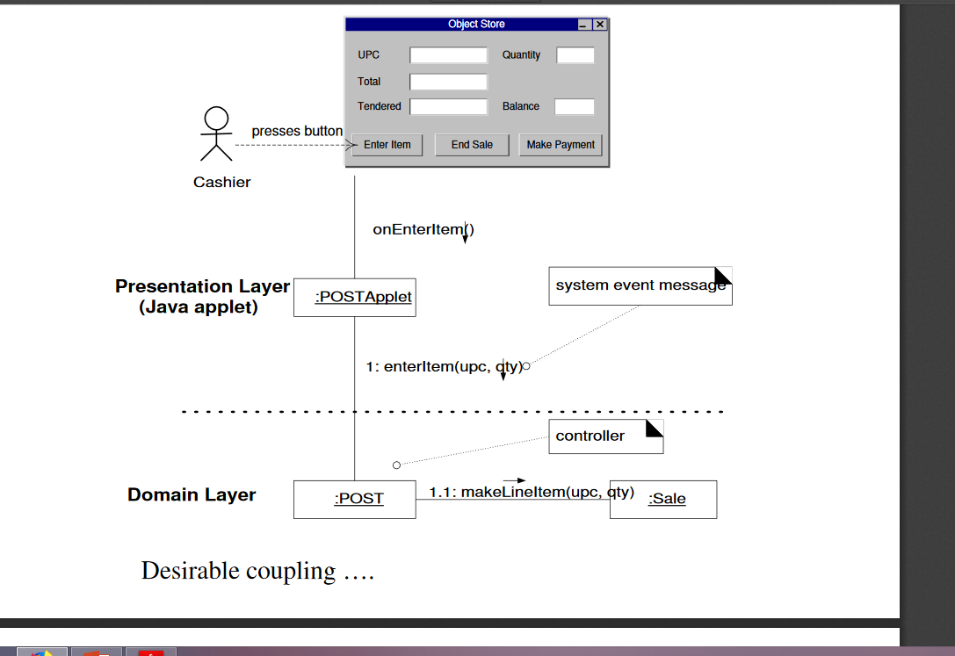

Slide 35
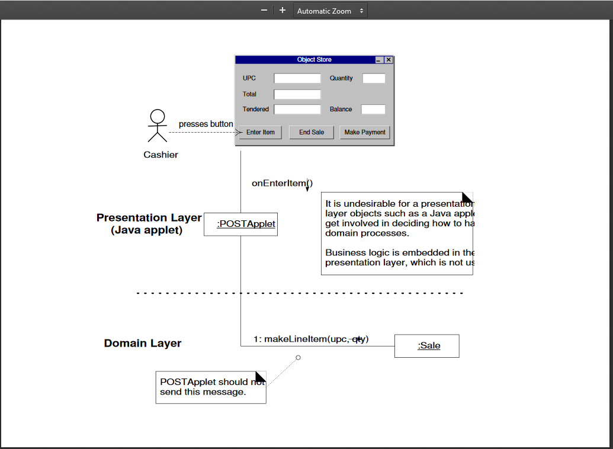

Slide 36
Controller
A Controller is a non-user interface object responsible for receiving or handling a system event.
A Controller may represent a receiver of a signal or a handler of all system events in a use case scenario.
Input events might come from
a GUI operated by a person, or
a call from a telecommunications switch, or
a signal from a sensor, etc.
(Note that classes such as window, applet, widget, view, document, etc. are not used. These kinds of classes do not fulfill the tasks associated with system events; rather, these typically receive events and delegate them to some kind of controller.)

Slide 37
Controller Pattern: System Events
Most applications have ‘System Events.’
Typically the ‘system’ is modeled as a class during analysis
Consider: (Larman)
System
endSale()
enterItem()
makeNewSale()
makePayment()
…
Do not infer that there will be a class named System in Design.
Rather, during Design, a Controller class is assigned the responsibilities for
system operations.
Remember who is developing requirements and performing analysis…..
We simply do not know what the implementation (solution) will be at this time.

Slide 38
Controller:
Who is the Controller for System Events?
Presumably, there is an interface layer (a GUI, sensor activation, other things…) that needs to send a message (a system event message) to the application or domain layer
A Controller (coordinator…) is the class of object that is responsible for receiving such a message and delegating the follow-on work to other objects.
A Controller object in this context is often a kind of
‘façade’ onto the domain layer from an interface layer.

Slide 39
Controller - Discussion
In all cases, some kind of ‘Handler’ for these events must be chosen.
It is this Controller Pattern that provides some guidance for generally acceptable suitable choices.
Again, a controller class is often some kind of façade into the domain (application) layer from the interface (boundary) layer.
Often, we have a single controller for an entire use case,
If so, then the state of the use case is maintained in the Controller.

Slide 40
Controller - Discussion
Several different kinds of Controllers.
Main two:
Façade controller, and
Use Case controller

Slide 41
Controllers – Categories: Façade Controller
This kind of controller in design may represent the system, a device, or a subsystem, as we have stated.
Select some class name that suggests a ‘cover’ or façade over the other layers of the application, and that provides the main point of service calls from the UI layer down to other layers.
Again, it is a class that represents the entire software system or subsystem.
Note: ‘Façade’ Controllers are used when there are not too many events to control, and there is not sufficient need for alternating controllers.

Slide 42
Controllers – Categories: Use Case Controller
Use Case Controllers – Usually a different controller for each use case
Note that a use case controller is NOT a domain object; in fact, it is a fabrication used to handle events.
Consider switching to a use case controller when a façade controller starts becoming too large and starts to lose cohesion and starts having high coupling.
A use case controller is a good choice when there are a number of system events across different processes; it factors their handling into manageable classes and
Also forms the basis for knowing the state of the current scenario in progress.

Slide 43
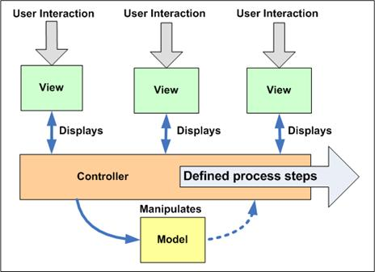
The Use Case Controller Pattern

Slide 44
Additional Controllers: Page and Front
Two other design patterns related to Use Case controllers:
Page Controller, and
Front Controller
In a Page Controller pattern, the controller uses a single Presenter which interacts with the Model (the data for the page). When it receives a request, the Page Controller can determine which partial View to display within the page, and then interact with that View following the MVP pattern.
In the Front Controller pattern, a separate controller examines each request and determines which page to display. Each page is a complete MVP implementation, with its own View, and each Presenter interacts with the View and the Model (the data)

Slide 45
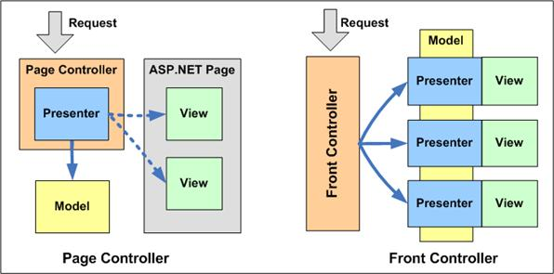

Slide 46
Presenter
Model–View–Presenter (MVP) is a derivative of the Model–View–Controller (MVC) software pattern, also used mostly for building user interfaces.
In MVP the presenter assumes the functionality of the "middle-man" (played by the controller in MVC).
Additionally, the view is responsible for handling the UI events (like mouseDown, keyDown, etc), which is normally the controller's job.
Eventually, the Model becomes strictly a domain model.

Slide 47
Presenter - more
MVP is a user interface design pattern engineered to facilitate automated unit testing and improve the separation of concerns in presentation logic:
The Model is an interface defining the data to be displayed or otherwise acted upon in the user interface.
The View is an interface that displays data (the model) and routes user commands (events) to the Presenter to act upon that data.
The Presenter acts upon the model and the view. It retrieves data from repositories (the model), and formats it for display in the view.

Slide 48
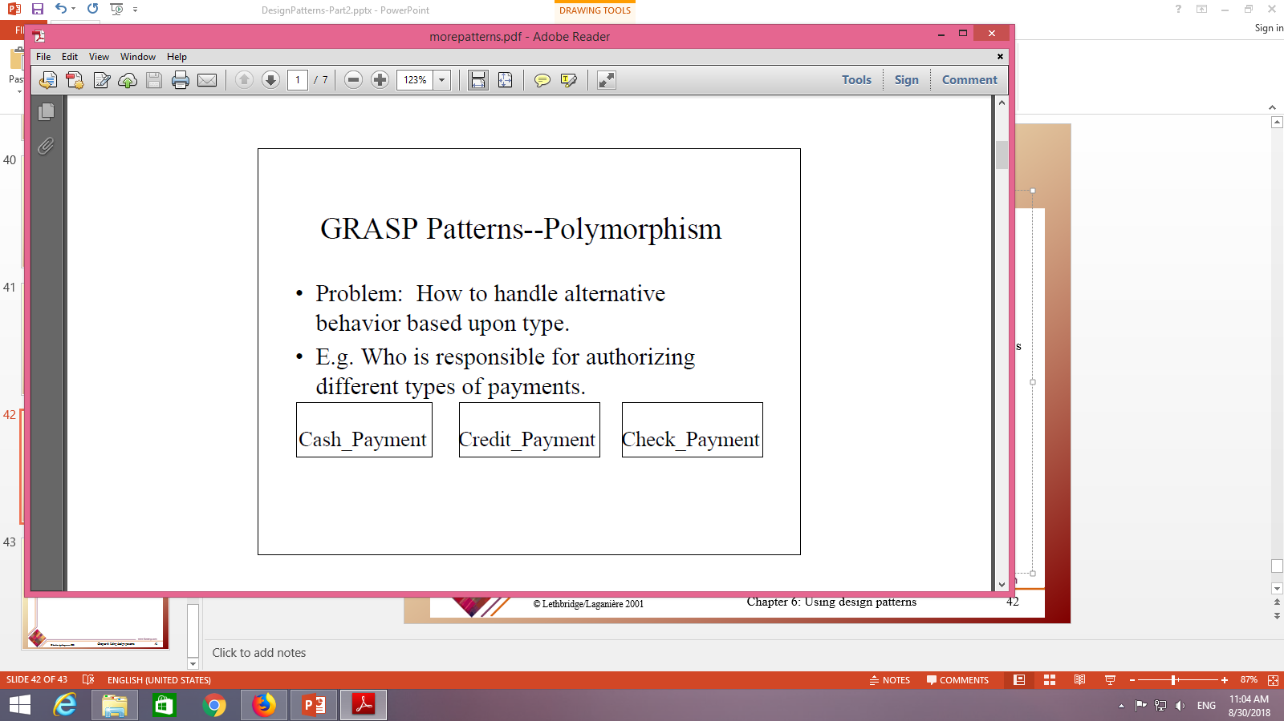

Slide 49
